Slide 1
Eutychus
Patron Saint of All Who Sleep in Church

Slide 2

Patron Saint of All who Sleep in Church!
The Story of Eutychus
  Acts 20:7-12
“And they took the youth away alive, and were not a little comforted”
Notes:
Read Eutychus
Zion Litchfield Story -

Slide 3

Eutychus as Paradigm
Eutychus is….
  Young
  Bored
  At Risk
  Nobody Notices

Slide 4


Eutychus
Neania
Paiv
Notes:
Beginning and end of story

Slide 5
What Aren’t We Noticing?
Christian youth soaking up the culture rather than Christian faith
  Cultural Captivity
    Nancy Pearcey
  Moralistic Therapeutic Deism
    Christian Smith
  Generic Youth Ministry
    Mark Oestreicher

Slide 6
Generic Youth Ministry?
Is youth ministry such a generic activity that it really makes no difference what my belief are about Scripture, justification, or the sacraments? Is it all pretty much the same?
YM Textbook Resources….
  Youth Specialties
  Zondervan
  InterVarsity
  Fuller Youth Institute
  Baker
  Jossey-Bass
Notes:
Lack Means of Grace!

Slide 7

Lutheran Youth Ministry?
If there are distinctive qualities brought to youth ministry by Lutheran theology, what are they? How would I notice them? How could I incorporate them into a youth ministry training curriculum?

Slide 8

In the Beginning was the Walther League
Worship
Education
Service
Fellowship
Recreation

Slide 9
100 Years Later – Doug Fields
Walther League
Purpose Driven YM
Worship
Education
Service
Fellowship
Recreation
Worship
Discipleship
Ministry
Fellowship
Evangelism
Notes:
Let’s make it a list of six

Slide 10
Biblical Curriculum Guide
Ephesians 4:11-14 (ESV)
  “And he gave the apostles, the prophets, the evangelists, the shepherds and teachers, to equip the saints for the work of ministry, for building up the body of Christ, until we all attain to the unity of the faith and of the knowledge of the Son of God, to mature manhood, to the measure of the stature of the fullness of Christ, so that we may no longer be children tossed to and fro…”
Notes:
I want to build a curriculum for youth ministry

Slide 11
Curriculum Guide for YM
Ephesians 4:11-13
  Unity of faith and knowledge of the Son of God
  Mature manhood (Adulthood)
  To the measure of the stature of the fullness of Christ
Notes:
1 – Unity in a culture that prizes diversity
2 – Maturity in culture that prizes immaturity
21 is the new 16
3 – Eschatological component

Slide 12
YM Curriculum of Ephesians 4
Mutual growth by young and old…
Who are learning and practicing practical wisdom…
As they express unity in faith…
And exercise maturity in their gifts…
While anticipating the promised fullness of Christ..
Accomplished within the community of believers…
Who are sustained by God’s gift of Means-of-Grace ministry.
Notes:
Explain practical wisdom – faith applied to life
Law 7 Gospel
Express unity & exercise maturity

Slide 13

A Trinitarian Framework
What in Lutheran Theology supports the Ephesians 4 Curriculum?
Notes:
Create a theological framework
A set of filters that will account
For observable behaviors

Slide 14
Trinitarian Framework for YM
Third Article Gifts
First Article Gifts
Second Article
Creedal Paradigm
Third Article gifts using First Article gifts for Second Article Faith

Slide 15
Trinitarian Framework for YM
Third Article Gifts
First Article Gifts
Second Article
Creedal Paradigm
Or put another way…
The means of grace received through created gifts to strengthen faith in Jesus Christ

Slide 16
First Article Gifts
Gifts from Below
Because I am created…
I have a body and soul
Notes:
Explain “gifts from Below”
Everyone has these

Slide 17
First Article Gifts
Gifts from Below
Because I am created…
I have the Imago Dei
  (though corrupted by sin)

Slide 18
First Article Gifts
Gifts from Below
Because I am created…
I develop according to plan
  Physically
  Cognitively
  Socially
  Emotionally
  Spiritually
Notes:
Physically – Fat and Menarche (Secular Trend)
Tricia and & Anacephaly
Cognitively – Observable patterns
Socially – Erikson/Kohlberg
Emotionally – Dealing with disappointment
Spiritually – 8th grade faith/adult world
How Complex?

Slide 19
Development Happens Independently and Asynchronously
 | Social Age | Emotional Age | Intellectual Age | Physical Age | Spiritual Age
Emily Age 13 | 10 | 16 | 13 | 18 | 8
Todd Age 13 | 17 | 14 | 9 | 11 | 14
Micah Age 13 | 12 | 10 | 17 | 14 | 18

Slide 20

Life Experience
First Article Gifts
Gifts from Below
As a fallen being in a fallen world my life experience is mediated through…
My Social Context
  Family
  Peers
  School
  Congregation
Notes:
Challenge – Calling some of these gifts.
Positive/Negative

Slide 21
Life Experience
First Article Gifts
Gifts from Below
As a fallen being in a fallen world my life experience is mediated through…
My Culture
  Media
  Ethnicity
  Nation
Notes:
How powerful is Media?
What advantages/dis by ethnicity
Attitudes by nation

Slide 22


Needs
Life Experience
First Article Gifts
Felt Needs
Expressed Needs
Comparative Needs
Normative Needs
Gifts from Below
Notes:
“I don’t know why I did it!” – Telling truth
Normative – not desired but required

Slide 23
Third Article Gifts
The Holy Spirit working through…
The Word
  Preached
  Read
  Mediated
Creates and nurtures faith & spirituality
Gifts from Above
Notes:
Power of the Word

Slide 24
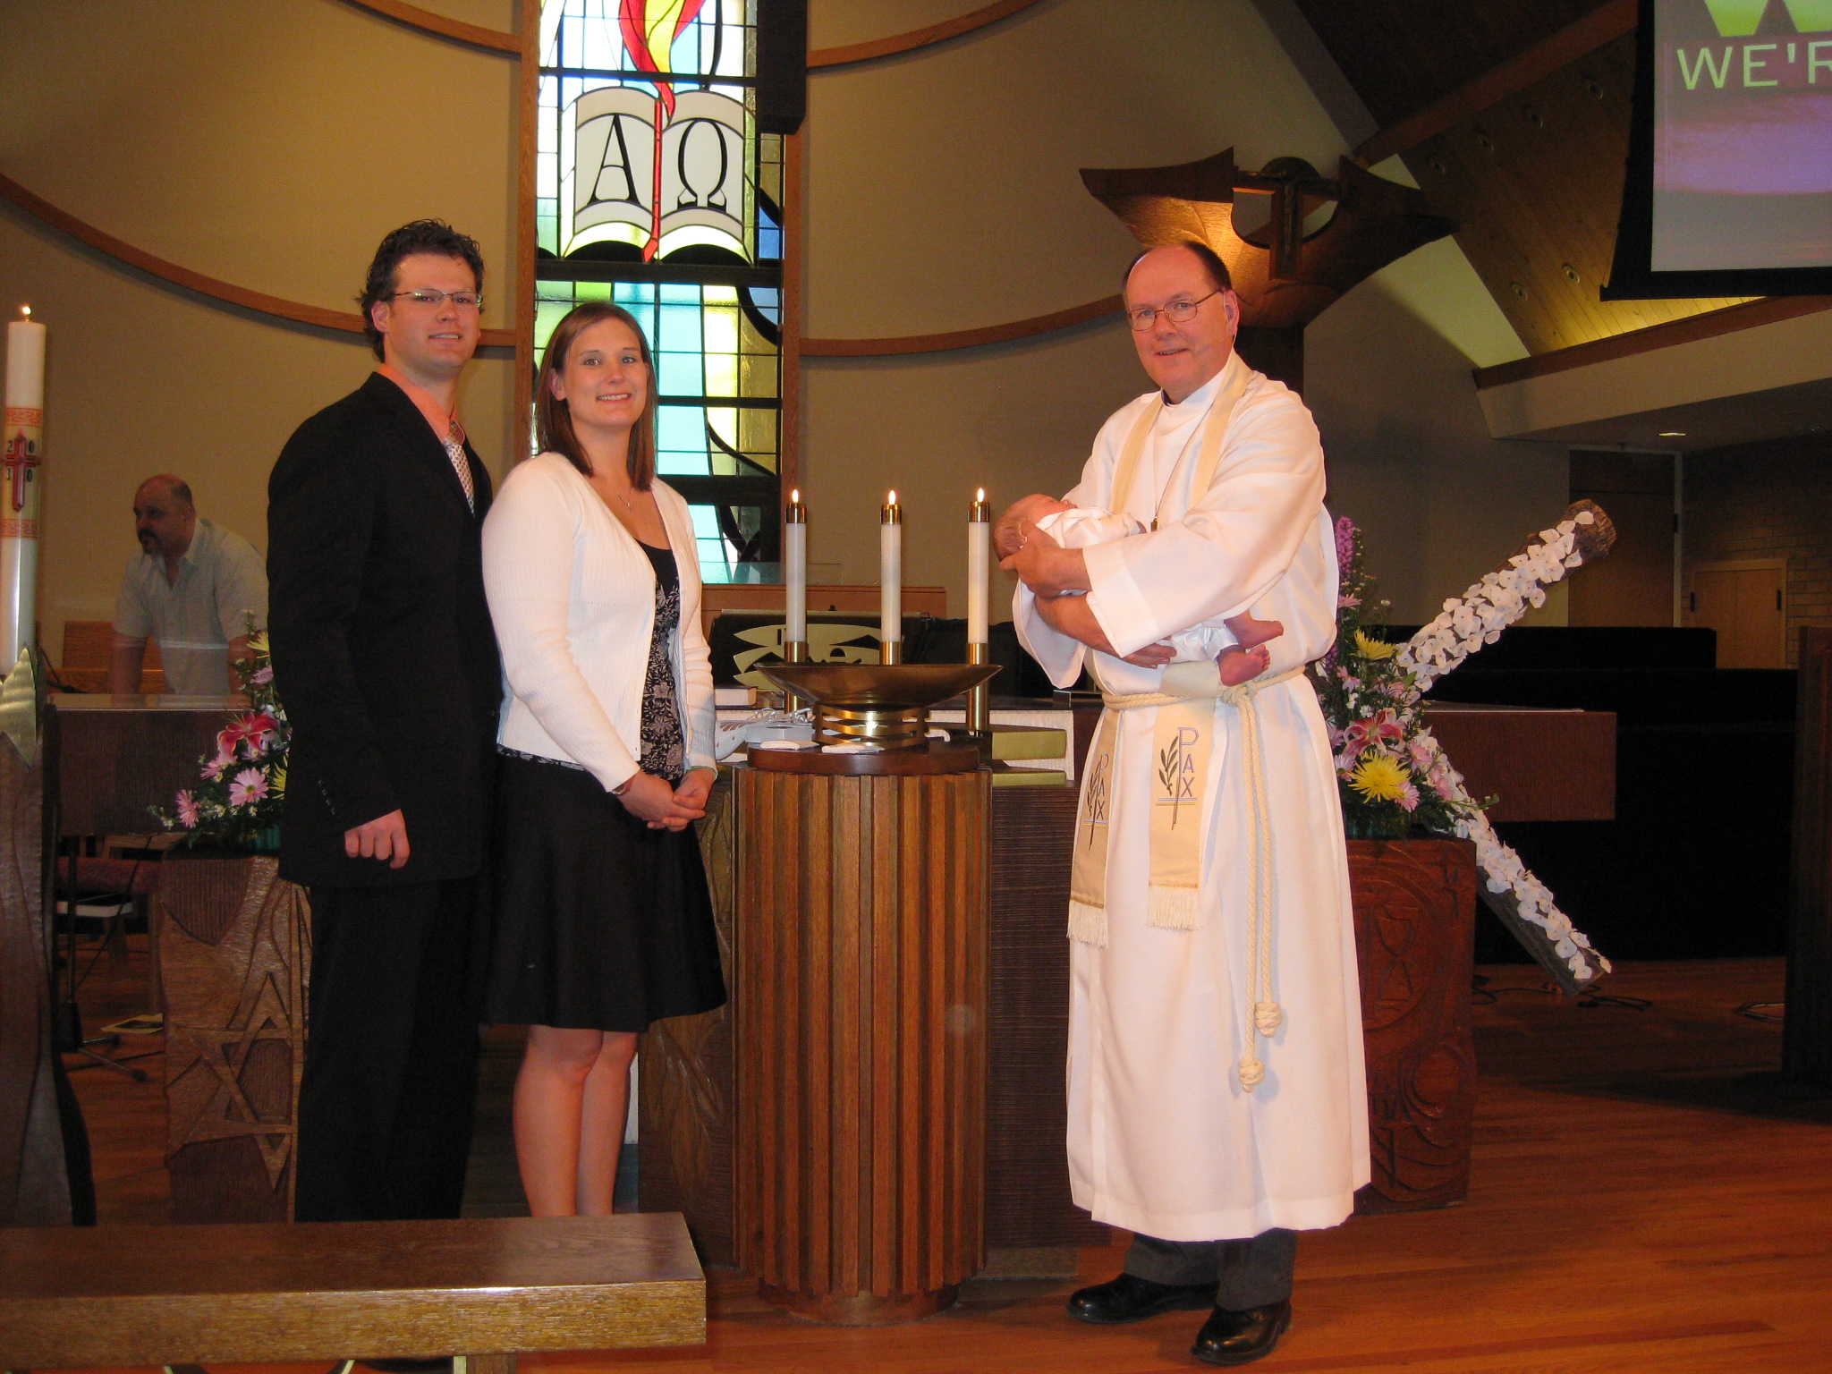
Notes:
He’s now a year old – Ethan Stamm

Slide 25
Third Article Gifts
The Holy Spirit working through…
The Sacraments
  Received
  Remembered
  Empower
Creates and nurtures faith & spirituality
Gifts from Above

Slide 26
Third Article Gifts
Christian Community
The Gathering of
Believers where…
Christian life is OBSERVED
Christian life is ABSORBED
Christian life is ABSOLVED
Gifts from Above
Notes:
Congregation is a gift to the believer.
Careful what we say about the church
It is the BRIDE of CHRIST!

Slide 27
Third Article Gifts
Christian Community
In a community dedicated to
Worship
Nurture
Fellowship
Outreach
Service
Gifts from Above

Slide 28
Third Article Gifts
Christian Community
Servant Skill
Everything God has given me to be in service to those entrusted to my care…
Gifts from Above

Slide 29
Third Article Gifts
Christian Community
Servant Skill
My faith
My training
My theological wisdom to…
  Rightly divide Law and Gospel
  Grow in faith in a life of sanctification
Gifts from Above

Slide 30
Third Article Gifts
Christian Community
Servant Skill
The Ministry Moment:
Second Article Faith
Ministry Moment
Needs
Life Experience
First Article Gifts
Notes:
Sarah’s story at life fest.
God gives the words

Slide 31
Trinitarian Framework for YM
Third Article Gifts
First Article Gifts
Second Article
Creedal Paradigm
Lutheran theology provides a Trinitarian theological framework for youth ministry

Slide 32
Trinitarian Youth
“Practical Theology” for Youth Ministry
  Unity of faith and knowledge of the Son of God
  Mature adulthood
  The stature of the fullness of Christ

